Slide 1
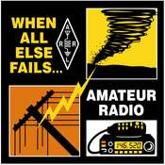
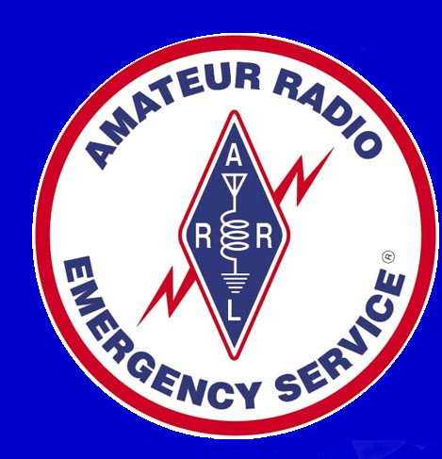
Introduction to
Amateur Radio Emergency Service (ARES)
and
Radio Amateur Civil Emergency Service
(RACES)

Slide 2
Amateur Radio
The Communications Act of 1934 created the FCC and acknowledged “amateur” radio as a service that could fill the need for a pool of experts who could provide backup communications during emergencies.
The FCC also acknowledged the ability of the hobby to advance radio technology and to enhance international goodwill.
Amateur Radio operators are required to pass a series of FCC written exams.

Slide 3
Amateur Radio
The FCC has assigned large portions of the radio spectrum for amateur use. In return, amateurs are expected to use these privileges to provide communications assistance to the public in times of need or distress.
There are about 750,000 Amateur Radio Operators (ARO's, HAMS) in the Unites States.
Nebraska's population of hams is about 4,100.

Slide 4
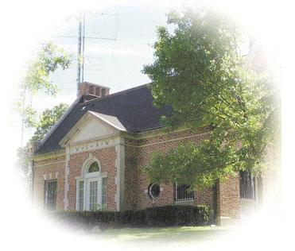
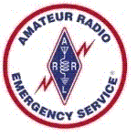
ARRL Overview
The “American Radio Relay League” was founded in 1914.
ARRL is the nation’s largest amateur radio organization, with 160,000 members and headquarters in Newington, CT.
About 1,500 ARRL members in Nebraska.

Slide 5
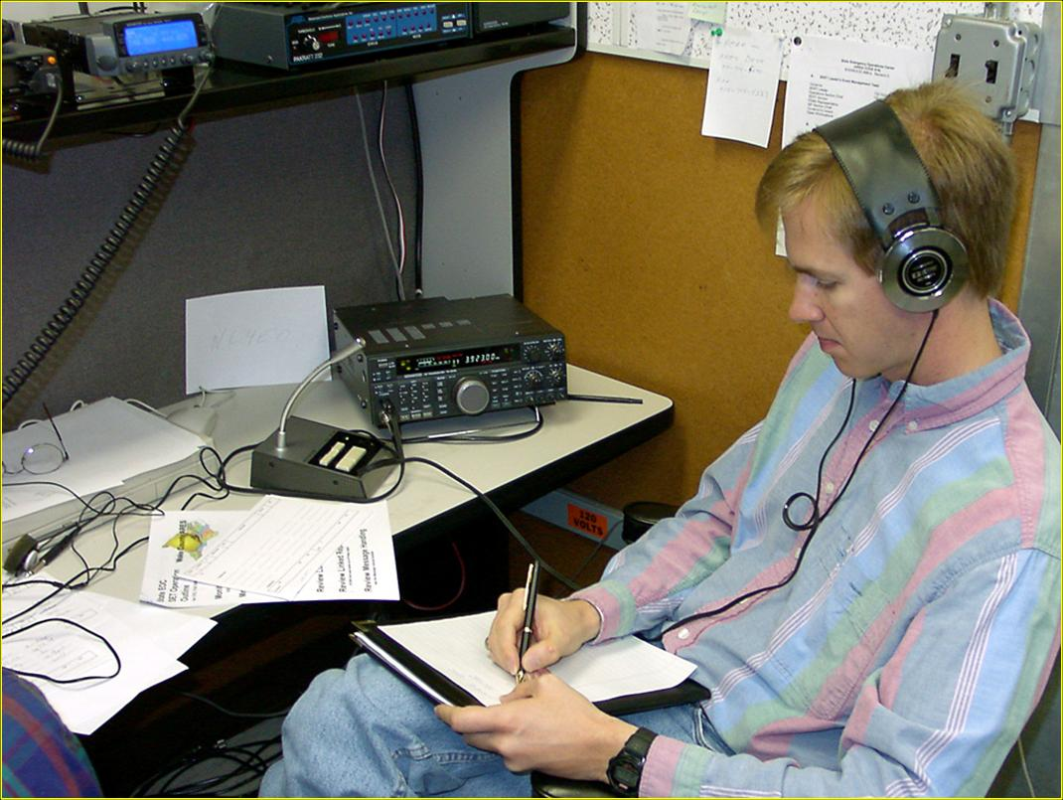
Amateur Radio
The Amateur Radio Emergency Service or “ARES” was established in 1935 as part of the ARRL field organization.
ARES consists of licensed amateurs who have voluntarily registered their qualifications and equipment for communications duty in the public service when disaster strikes.

Slide 6
What is ARES?
ARES (Amateur Radio Emergency Service)
The emergency communications arm of the ARRL (American Radio Relay League).
Not directly connected with any government entity.
Organized on a section-by-section basis within the ARRL field organization and responds on a local or regional level.
We are the Nebraska Section in the Midwest Division
ARES operators provide their own insurance.
You become an ARES amateur radio operator by joining ARRL, but you do not need to be a member of ARRL to participate in ARES.
ARES volunteers provide communications for:
Government Agencies
Disaster relief organizations
Public Service events
Emergencies or disasters
Training exercises

Slide 7
What is RACES?
— RACES (Radio Amateur Civil Emergency Service)
— A civilian entity established by the federal government after World War II
— A radio service using amateur radio stations or civil defense communications during periods of local, regional or national civil emergencies.
— Now the communications branch of FEMA.
— When a governmental entity (City, County, State or Federal) requests amateur radio assistance, the response is through RACES.
— Defined under Part 97 of the FCC Rules (47 C.F.R. 97.407) RACES operators are covered by government insurance.
— You become a RACES amateur radio operator by signing up for DSW and registering with your local ARES/RACES organization.

Slide 8
ARES versus RACES
Think of ARES as “civilian” and RACES as “government; ARES as “no insurance” and RACES as “insured.”
During a “non-declared emergency”, ARES can operate under ARES, but when the emergency or disaster is officially declared by a governmental authority, the operation can become RACES with no change in personnel or frequencies.
Each county in Nebraska will have / has an ARES Emergency Coordinator position, and the person in that position maybe also that counties RACES Radio Officer.
At the county level is the ARES District Emergency Coordinator who is also the RACES Chief Radio Operator.

Slide 9
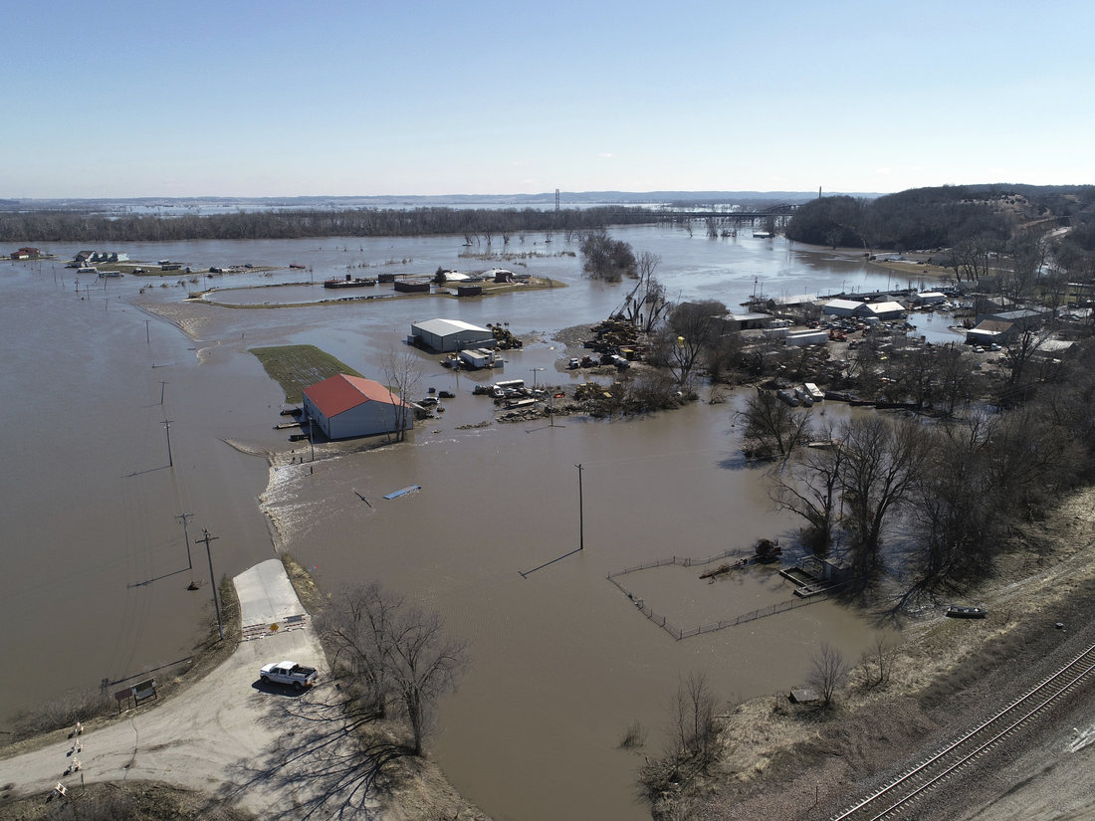
Nebraska March 2019

Slide 10
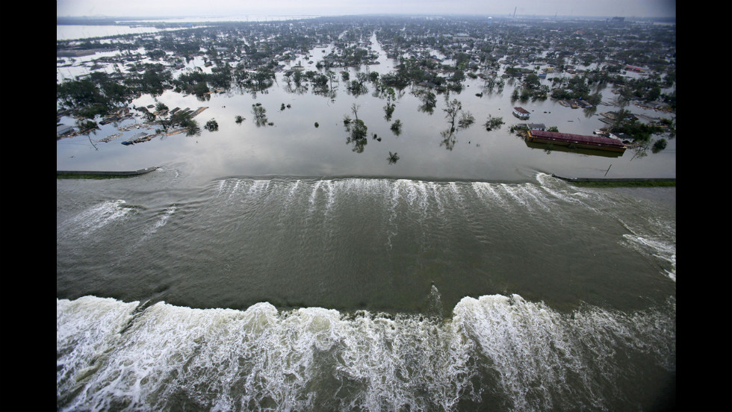
Nebraska March 2019​

Slide 11
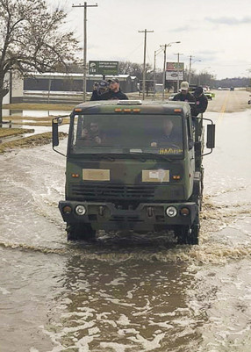
Nebraska March 2019
Fremont, Nebraska
Volunteers using Nebraska Forest Service​ Equipment

Slide 12
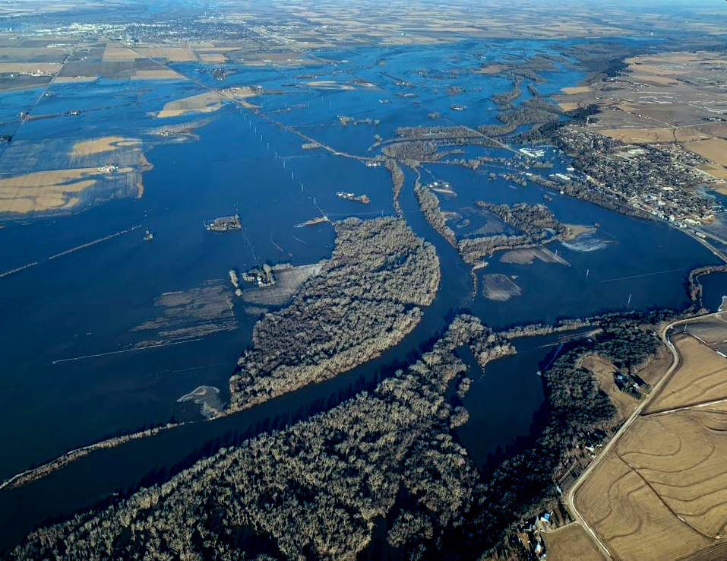
Nebraska March 2019​

Slide 13
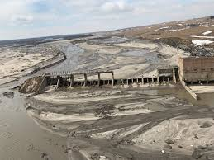
Nebraska March 2019

Slide 14
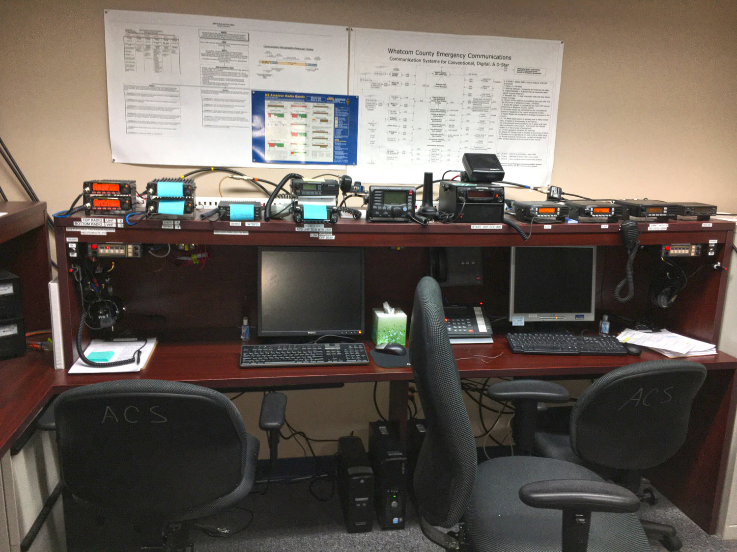
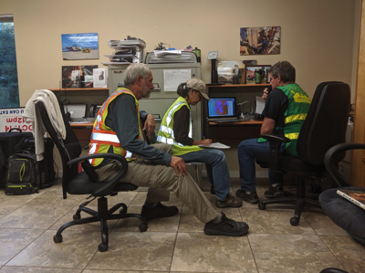
ARES stations at EOC’s
Simple Computer VHF Radio
Complex Multi-Computers VHF - UHF Radio

Slide 15
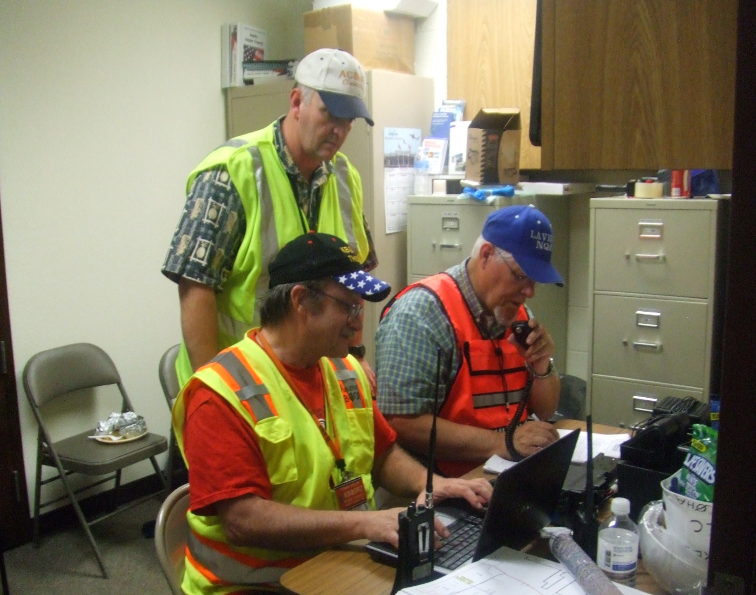

Slide 16
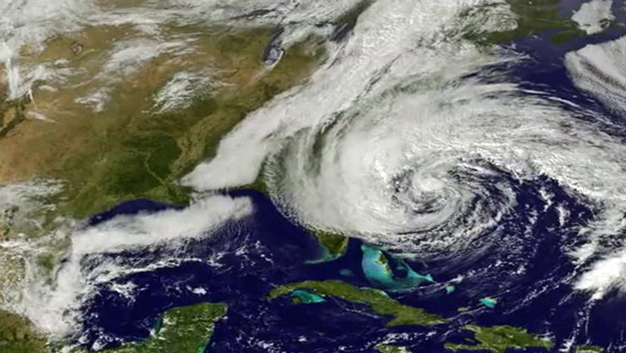
Hurricane Sandy

Slide 17
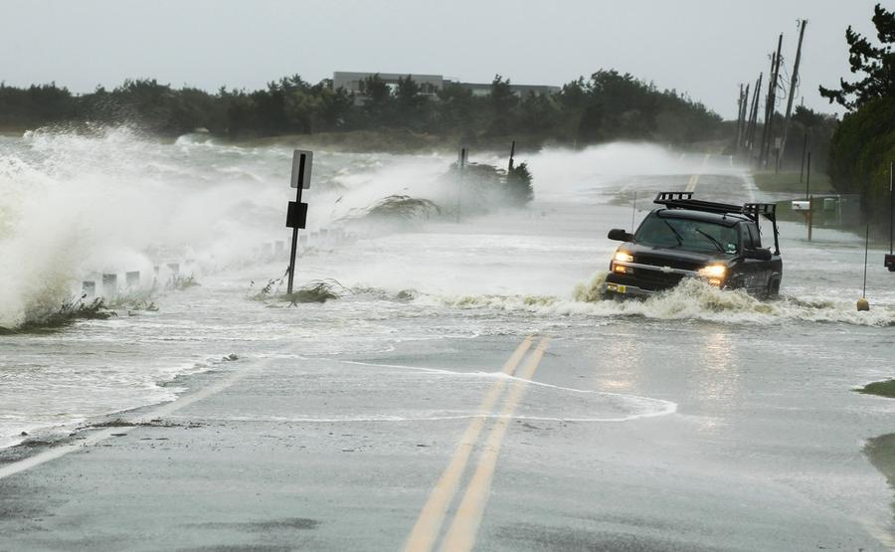
Hurricane Sandy

Slide 18
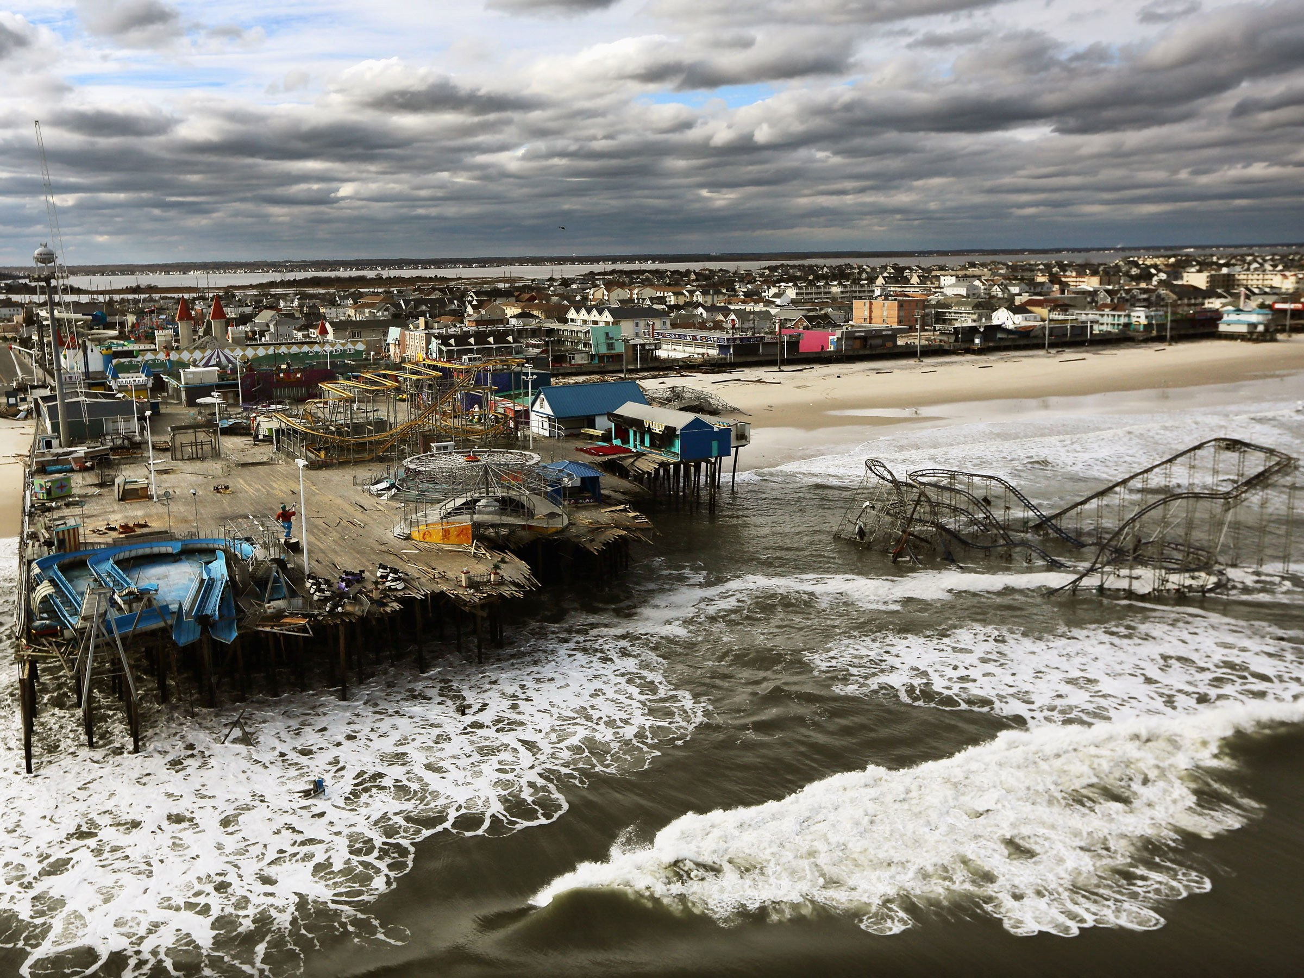
Hurricane Sandy

Slide 19
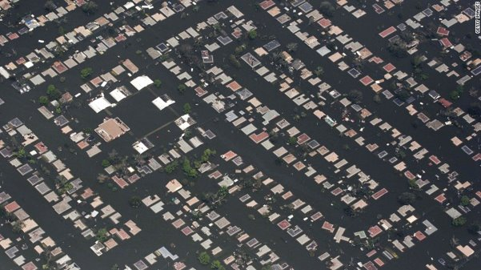
Hurricane Katrina​

Slide 20
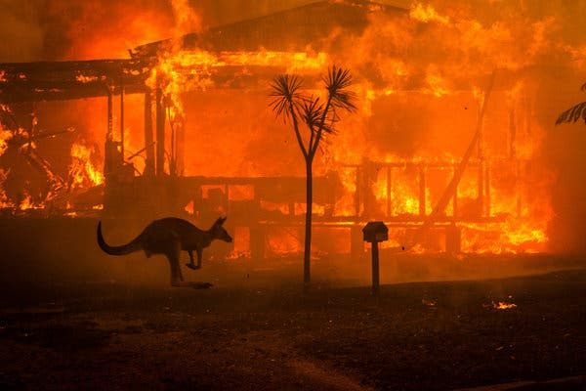
Australia 2019-2020

Slide 21
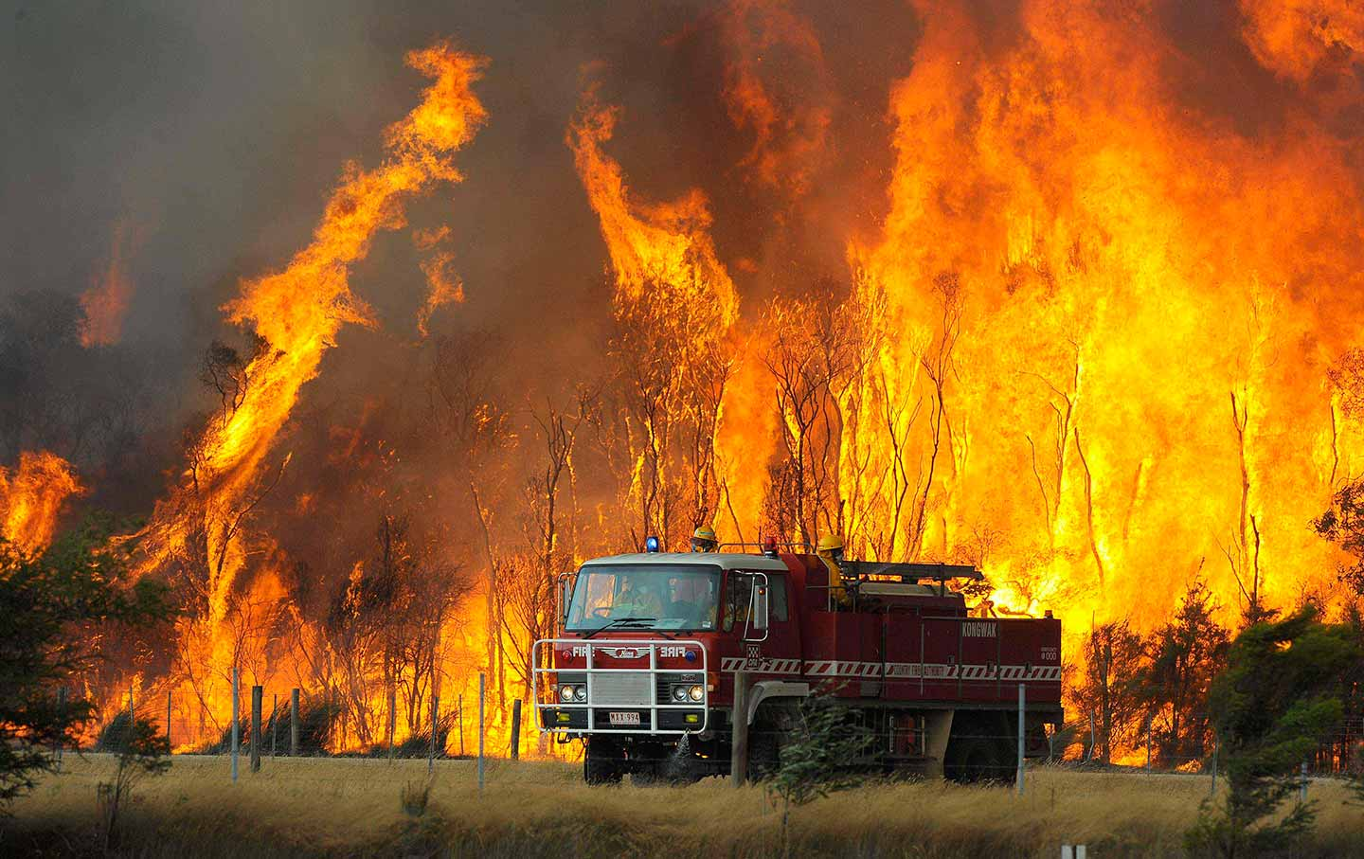
Australia 2019-2020

Slide 22
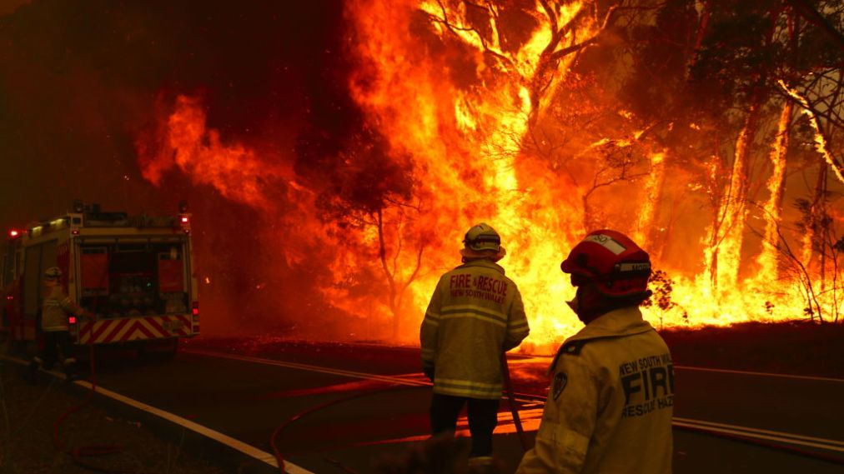
Australia 2019-2020

Slide 23
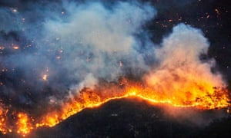
Australia 2019-2020

Slide 24
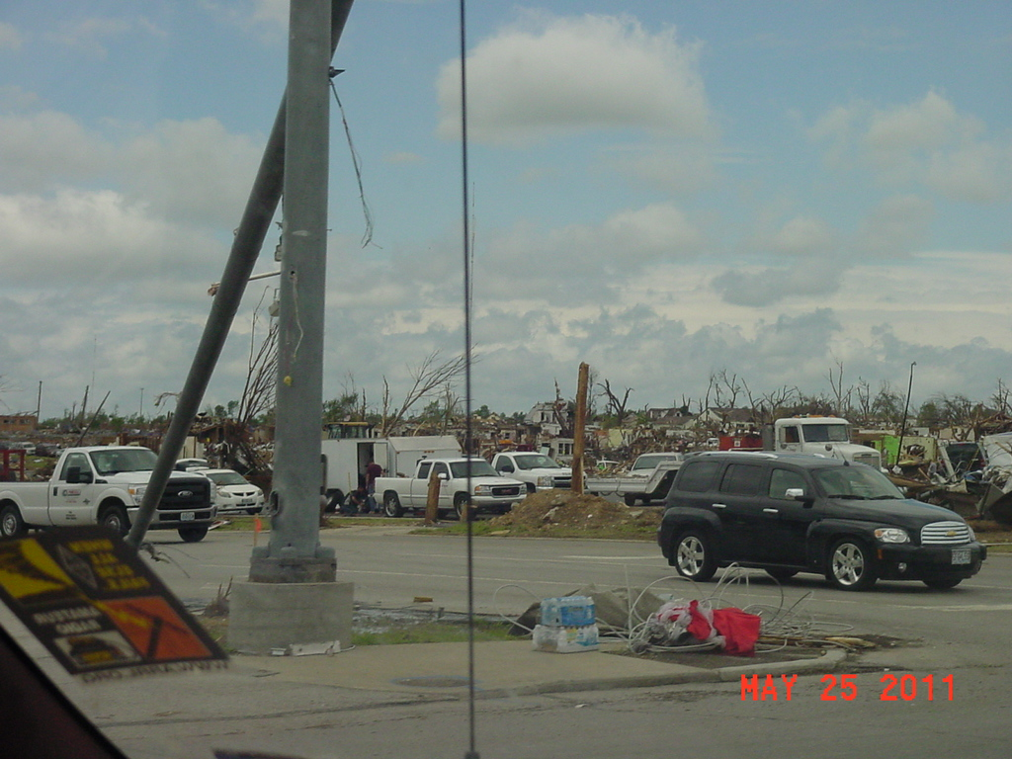
Joplin, Missouri

Slide 25
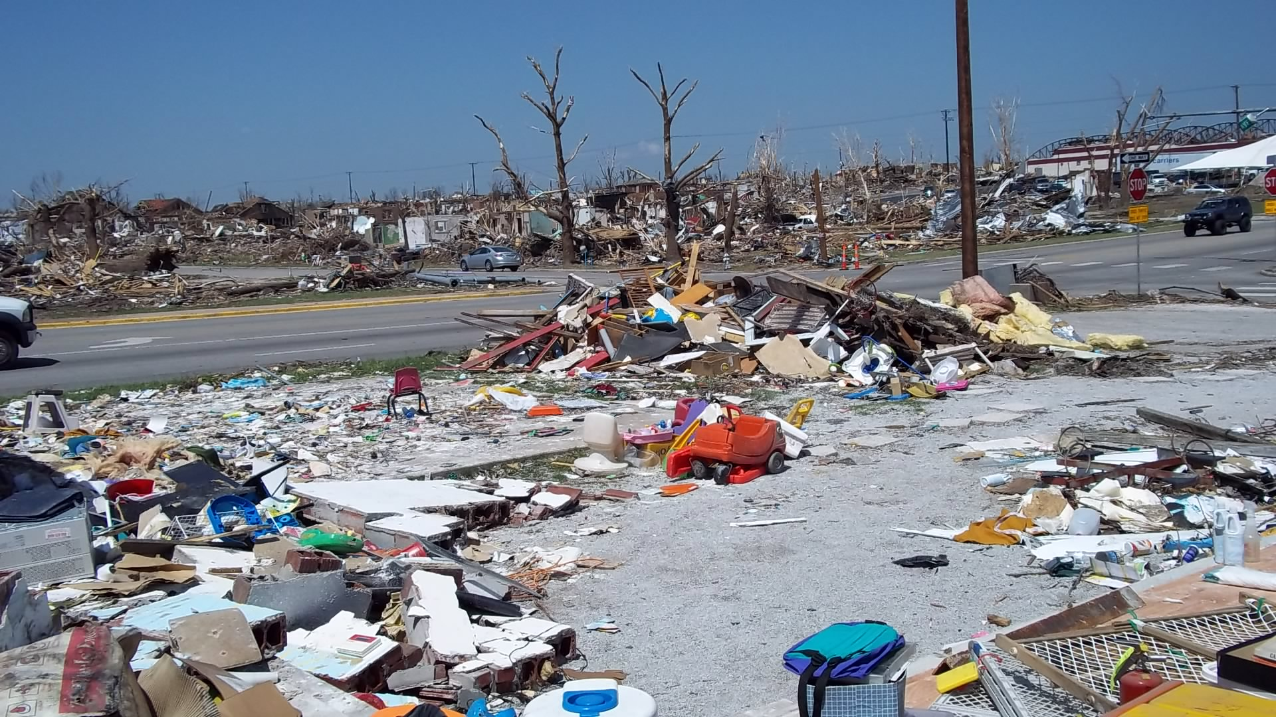
Joplin, Missouri

Slide 26
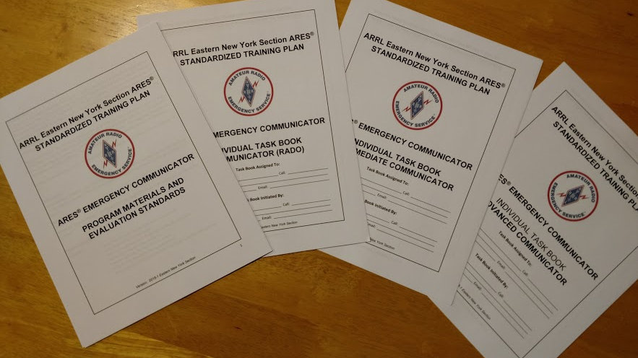
Path to success

Slide 27
ARES in Nebraska
Planned volunteer positions…….
6 District Emergency Coordinators (DEC)
24 Assistant District Emergency Coordinators (ADEC)
Up to 93 county Emergency Coordinators (EC)
As many Assistant Emergency Coordinators (AEC) as needed
2,000 Registered ARES Members

Slide 28
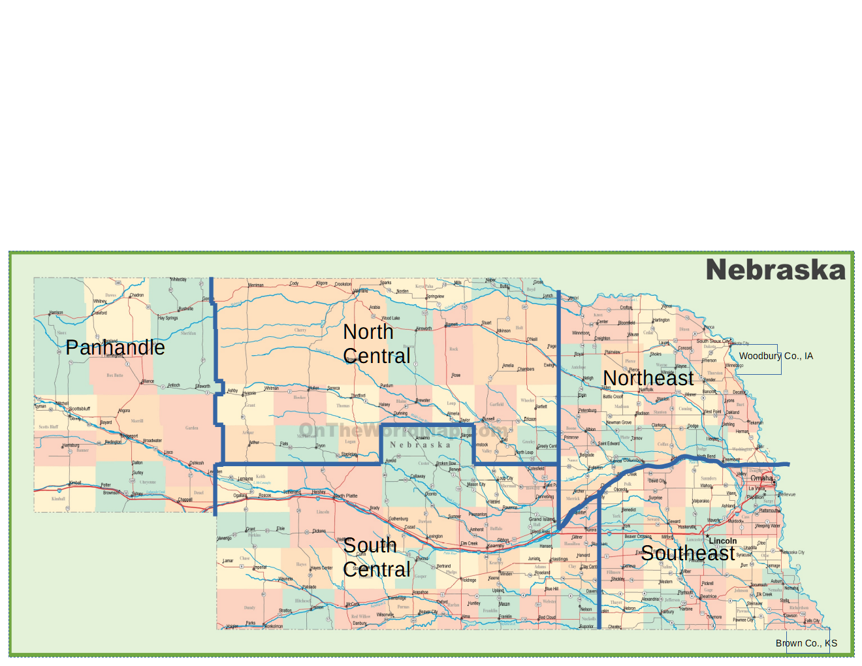
ARES Districts in Nebraska
******* District borders are not defined fully *******

Slide 29
ARES and ARRL
ARRL provides continuing education and a certification program for emergency communicators.
Emergency training networks hold on-air meetings daily / weekly depending on location.
The ARRL’s “National Traffic System” operates in manned or automatic mode 7x24, passing thousands of routine messages each day to maintain our preparedness for disasters.

Slide 30
ARES and ARRL
ARRL and other groups sponsor operating contests to help amateurs sharpen their on-air skills.
ARRL’s annual “Field Day” and “Simulated Emergency Test” provides training and tests our capability to handle large scale disasters.
Radio amateurs frequently assist local organizations by providing communications for special events (Red Cross, March of Dimes, MS Society, Juvenile Diabetes Association, Salvation Army, etc.).
Also assist state, county, local, cities and other Government agencies, FEMA, DOD, etc.

Slide 31
Why Amateur Radio?
Recent advances in telecommunications technology has provided more capability but not better reliability!
The US has the most reliable public telecommunications system in the world. BUT these services are still vulnerable to natural disasters and other failures!

Slide 32
Carrier Network Vulnerabilities
Increasing reliance on distributed power:
Rather than relying solely on central office-based power systems with large generators and battery banks, modern telecom networks now have fiber optic and multiplex equipment distributed throughout neighborhood.
Most of these sites only have batteries for backup power, with 4-8 hours of capacity. Carriers use portable generators to re-charge the batteries during a power outage.
There aren’t enough generators or personnel to handle widespread, long term power outages.

Slide 33
Carrier Network Vulnerabilities
Single Points of Failure:
Failures in central office switching equipment can cause regional outages.
Database problems can cause widespread, even national outages.
Fiber cuts on non-diverse routes can cause regional outages and congestion as traffic is shifted to other areas.

Slide 34
Carrier Network Vulnerabilities
Migration to Internet Protocol and Open Systems
Greater vulnerability to virus attacks and other security issues.
Convergence of voice and data networks – all our eggs are in one basket!
Industry Consolidation and Cost Cutting
Fewer companies, fewer networks, less diversity.

Slide 35
Wireless Network Vulnerabilities
Wireless Carriers are the Most Vulnerable
Many cell tower sites don’t have generator backup power.
Most rely on public landlines for connections back to switching centers, so they have the same exposure to failure as the landline network.

Slide 36
Satellite Services
Satellite services are an effective backup, but they have their own vulnerabilities:
Much lower capacity then terrestrial cell phone networks. Satellite services will quickly get overloaded in a major disaster.
Most satellite services rely on some terrestrial infrastructure, which may be vulnerable to disasters.
Users must be out of doors with a clear view of the sky.

Slide 37
What does Amateur Radio bring?
Public safety and critical infrastructure entities usually maintain private telecom networks to support their operations during a disaster.
Private networks that survive a disaster are usually overloaded as traffic shifts away from carrier networks.
Amateur radio can provide a critical backup capability!

Slide 38
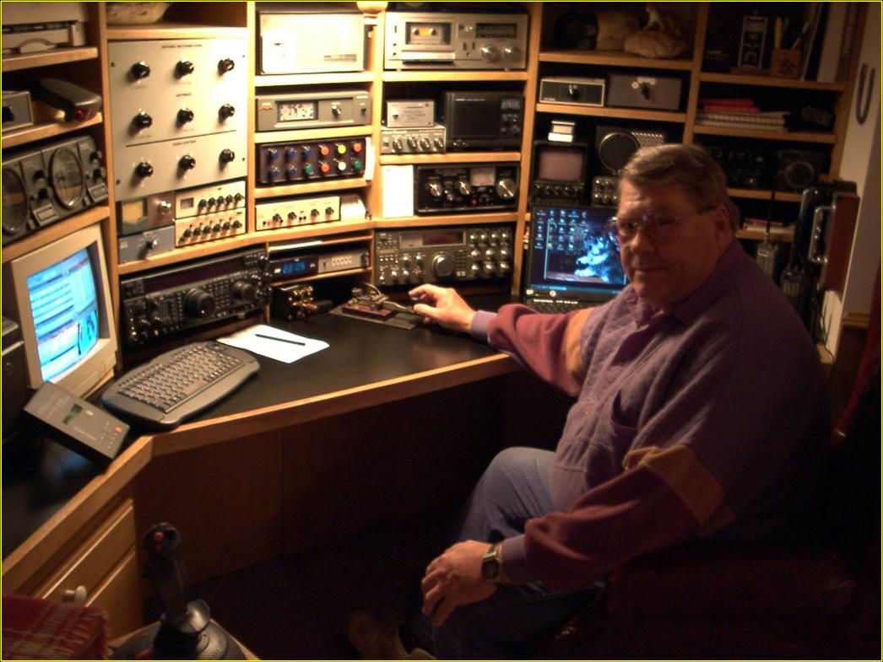
What does Amateur Radio bring?
Amateur radio can provide communications locally, regionally, nationally and even worldwide depending on the type equipment and antennas deployed. This capability utilizes no fixed telecom infrastructure, making amateur radio virtually immune to natural disasters.

Slide 39
What does Amateur Radio bring?
Amateur equipment and operators are widely distributed throughout the country and provide their own equipment.
Certified emergency communications operators maintain “go kits” with equipment, food, water and other supplies. This means amateur radio can be deployed quickly to disaster zones.
Thousands of radio amateurs are available to assist when local resources are exhausted.

Slide 40
Capability
Voice communications using FM and Single Sideband (SSB).
Digital communications using Morse code as well as a nationwide amateur radio “packet” network, with interfaces to Internet email.
Vehicle tracking using GPS and digital radios.
Amateur television.
Well established, nationwide network for relaying messages.

Slide 41
Limitations
Licensed operator is required at all times.
Messages are not private.
Long haul networks best suited for short, written messages (25 words or less).
Limited bandwidth when compared to modern Internet connections.
Inherent challenges of an all-volunteer service.

Slide 42
What do organizations think?
Volunteer ham radio operators are coming to the aid of relief agencies and
emergency officials to help with badly needed communications in areas of
Louisiana, Alabama and Mississippi ravaged early last week by Hurricane Katrina.
(Computerworld)
Puerto Rico is just one example where amateur radio stepped in and helped with
disaster recovery. You’ll find dedicated volunteers providing support in emergencies.
(PREMA)
Robb Mayberry is with the Office of Emergency Services in California. He says that
California works with amateur radio groups frequently, most recently during the
Ridgecrest earthquake in July.
Tom Smith, Emergency Management Director for Dodge County, said "The Pioneer
Amateur Radio Club of Fremont and the Dodge County ARES Team will be the first
to be called out in the event of these types of emergencies going forward.“
The 15 volunteers on the Arrowhead Skywarn Response Team work in shifts at the
NWS Duluth office during storms to receive on-the-ground weather observations
from amateur radio operators ...

Slide 43
Track Record
For almost 100 years radio amateurs have been building a proud tradition of public service.
ARES groups are activated to help in real emergencies somewhere in the US almost every week.
Both the White House and Congressional reports on Hurricane Katrina praised the role of more than 1,000 amateur radio operators who provided emergency communications during the disaster.
When all else fails…. amateur radio still works!

Slide 44
Contacts
— Section Manager:
Matt Anderson, KAØBOJ kaØboj@arrl.net
— Section Public Information Officer:
Justin Williamson, WJØTX wjØtx@arrl.net
— Section Emergency Coordinator:
Ed Holloway, KØRPT kØrpt@arrl.net
— Southeast District Emergency Coordinator:
Jim Nelson, WØJRN wØjrn@arrl.net
— Northeast District Emergency Coordinator:
Mike Gill, WØMEG wØmeg@arrl.net

Slide 45
Social Media​
Nebraska Section ARRL https://www.facebook.com/ARRLNebraskaSection
Nebraska Section ARES NEARES.net
Southeast District ARES https://www.facebook.com/ARESSoutheastNebraska
Bellevue ARC education@bellevuearc.org
Lincoln ARC class@k0kkv.org
Aksarben ARC (Omaha) education@aksarbenarc.org
Licensing Classes​

